Slide 1
2016.08 FALL ENG CS 6388.01 Model-Integrated Computing OCL Constraints
Venkataramana n
Ramanathan nk

Slide 2
Motivation
The goal is to provide capabilities to evaluate WebGME models against constraints written in OCL - (Object Constraint Language)
Currently the system only supports constraints written in javascript, that could obstruct developers in using the constraint concept.
There is an available library (https://github.com/SteKoe/ocl.js), that can parse OCL rules and evaluate them on specific javascript objects,the main goal would be to leverage this library.
The tasks for this project have been divided into 4 parts as shown in further slides

Slide 3
Flow of Project
Model
JSON Structure
JavaScript Code
Evaluate Constraint

Slide 4
Part 1- Generate JSON from model
To create a plugin for webgme that could translate the input model into a specific javascript object so that it could be evaluated against an OCL constraint (it can be given as a string input).
We have done this part where we generate two JSON data structures from a webgme model shown as below
A JSON data structure for language
A JSON data structure for the actual model

Slide 5
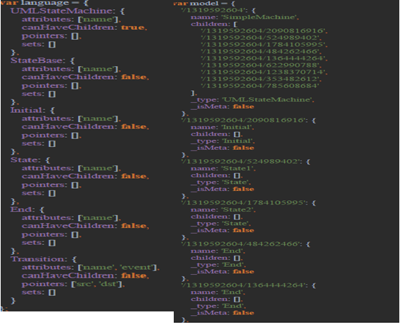
Example JSON for Language and Model

Slide 6
Part 2 – Generate JS Code using EJS
Using the EJS(Embedded JavaScript) we have generated Javascript code from the JSON object as shown in the following slide

Slide 7
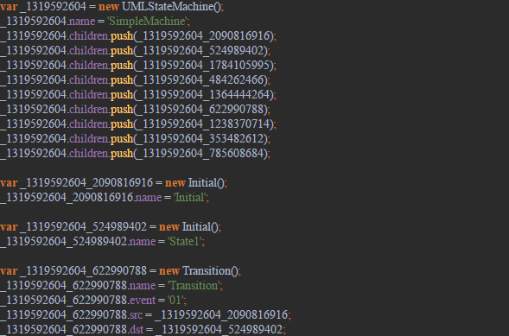
Example EJS

Slide 8
Part 3 – Check a Constraint statically
Now we use the OCL engine to evaluate our model against the constraints we have .
For example
var person = new Person(29); var car = new Car('red'); person.fleet.push(car); person.fleet.push(car); person.fleet.push(car); person.fleet.push(car);
Constraint
context Person inv: self.fleet->size() <= 3
The result of the above rule is FALSE.

Slide 9
Part 4 – Design a Visualizer
We made a visualizer which gives a text box to enter OCL constraints and embed them with the objects in webgme models. Then we added the capability of evaluation.

Slide 10
Applications
We could use this framework to develop scripts which could evaluate an entire model according to our custom constraints, which would be useful to teachers to automate correction of work of students.

Slide 11
Improvements
We could add more error handling features for the OCL.
We can have a better UI for the visualizer(maybe use codeMirror)

Slide 12
Thank-you
Questions ?

